Slide 1


Data Stories Behind Electric Vehicles in Washington State
Presented By: Sheena Knott, Ron Beatty, Makia Johnson, Yolanda Bustos

Slide 2
Electric Vehicles in Washington
Per energy.gov, Washington is known for having one of the largest number of electric vehicles
Data exploratory analysis to summarize county population, Base MSRP, electric ranges, eligibility data, & electric vehicle statistics in Washington
How electric vehicles collectively performing over time in Washington?
Resources
Project Summary - https://www.energy.gov/articles/history-electric-car
Geographic location data EV Washington Dataset - https://catalog.data.gov/dataset/electric-vehicle-population-data
Washington State Population - https://catalog.data.gov/dataset/waofm-april-1-population-by-state-county-and-city-1990-to-present
Vehicle Price – (1) https://insideevs.com/news/565883/electric-car-prices-us/ (2) https://insideevs.com/

Slide 3
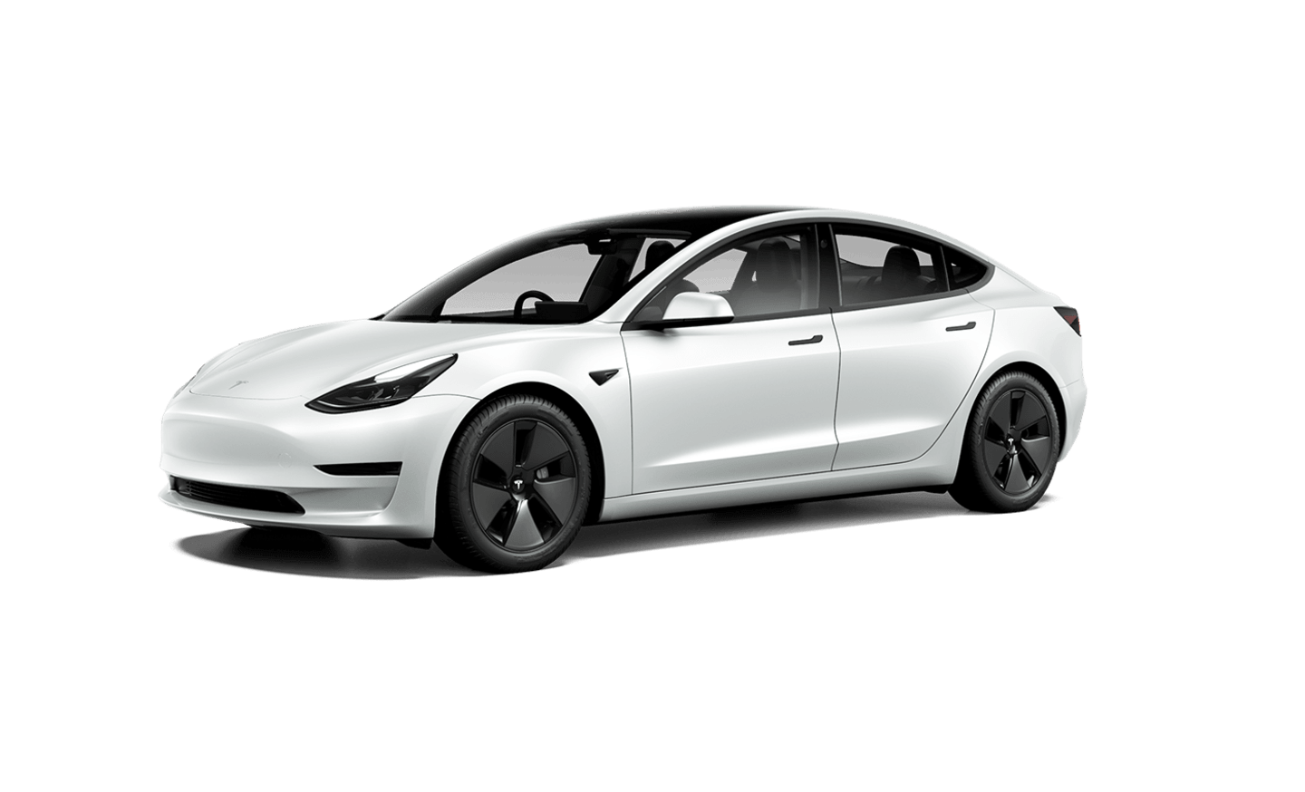
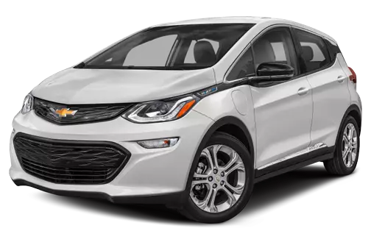
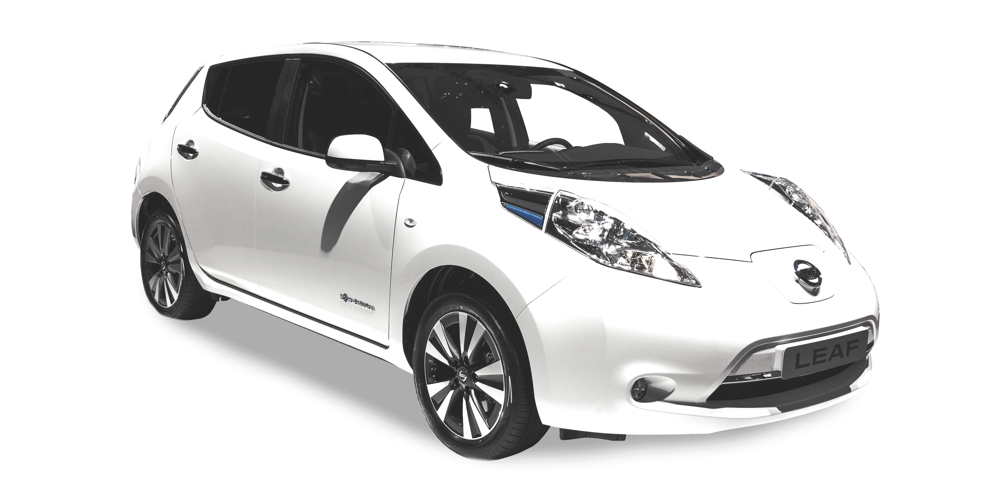

Most Popular Electric Vehicles in Washington
3rd Place: Chevrolet *11,528
2nd Place: Nissan *15,324
1st Place: Tesla *63,032

Slide 4
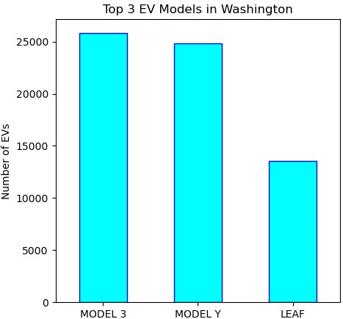
Top 3 Electric Vehicle Models
3rd Place: Nissan Leaf *13,554
2nd Place: Tesla Model Y *24,814
1st Place: Tesla Model 3 *25,843

Slide 5
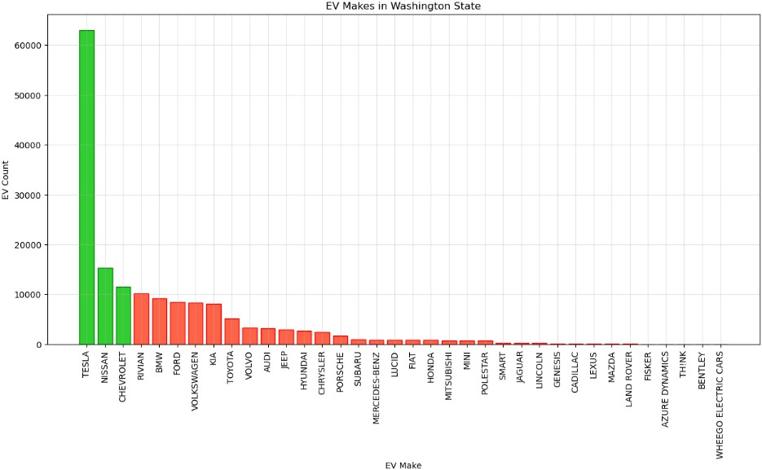
TESLA: EV FAVORITE CAR FUN FACT
Safety Is Priority with Tesla!
The Tesla Model S Scored Higher Than The Highest-Possible Safety Rating
Only Six Parts On A Tesla Car Need To Be Replaced At Normal Intervals
The Tesla Model X Can Turn Itself Into A Hospital Operating Room
Tesla Cars Pose A Danger To The Environment

Slide 6
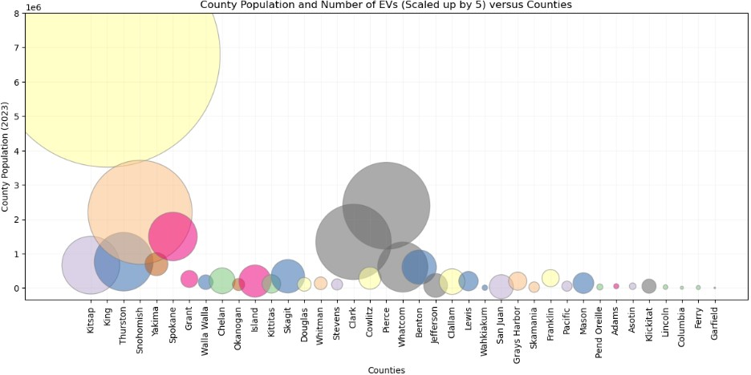
County Population vs. Number of EVs
King County (Seattle) has the largest county population and the largest number of Electric Vehicles
Population = 6.8M
Number of EVs = 85,602
Electric vehicles in King County have some of the lowest emissions of any vehicles in the country
Electric vehicles made up 11.2% of new vehicles registered in the Seattle metro area (King County).

Slide 7
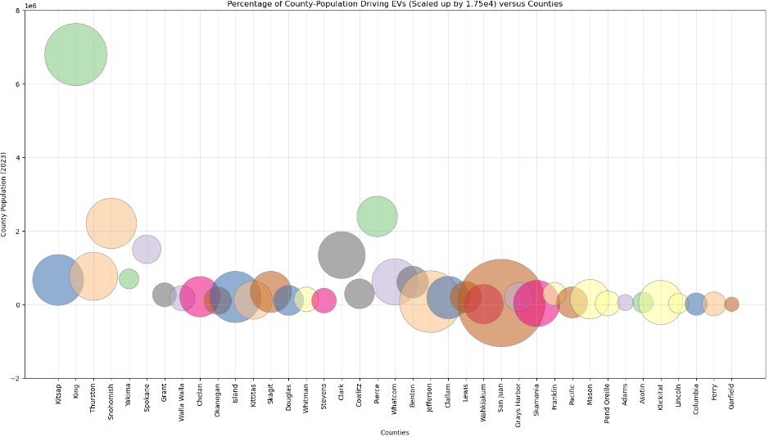
Percentage of County Population Driving EVs

Slide 8
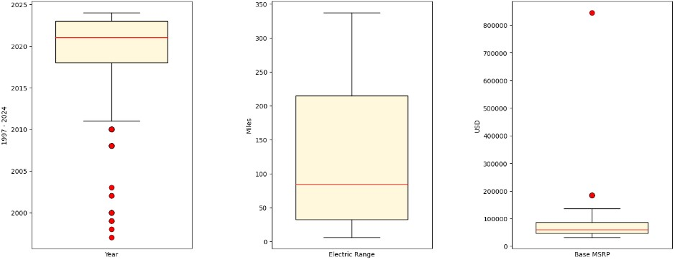
Summary Statistics Part II

Slide 9
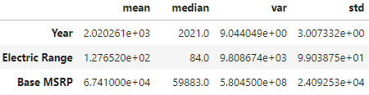
Summary Statistics Part I

Slide 10
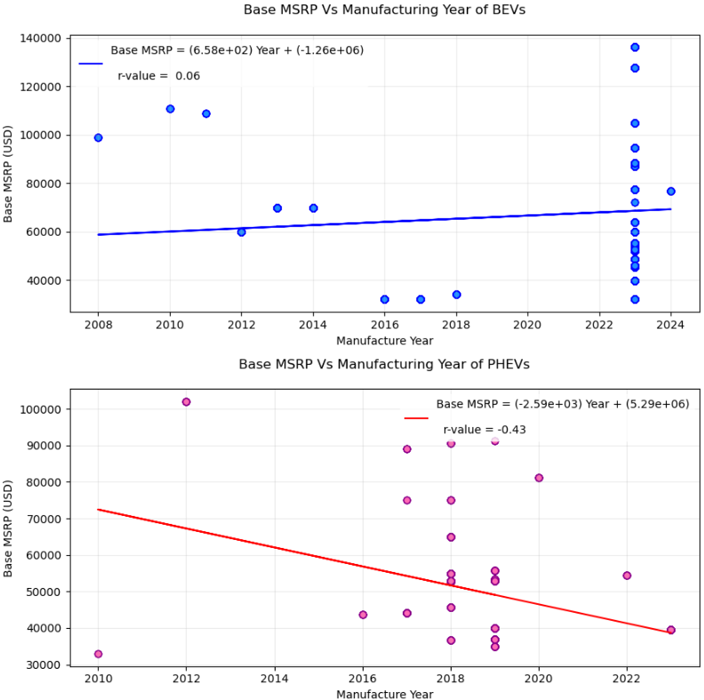
Base MSRP vs. Manufacturing Year BEVs & PHEVs
(BEV): slight increase in Base MSRP over time
(PHEV): decrease in Base MSRP over time

Slide 11

Electric Vehicle Terminology
Electric Range: An electric vehicle's range refers to the number of miles an EV can travel on a fully charged battery, or a single charge
Electric Range and efficiency aren't directly related
BEV is battery electric vehicle
PHEV is plug-in hybrid electric vehicle (fuel & battery)
Clean Alternative Fuel Vehicle Eligibility (CAFV): federal standard if EV covers 30 miles or more on a single battery charge; tax break if eligible

Slide 12
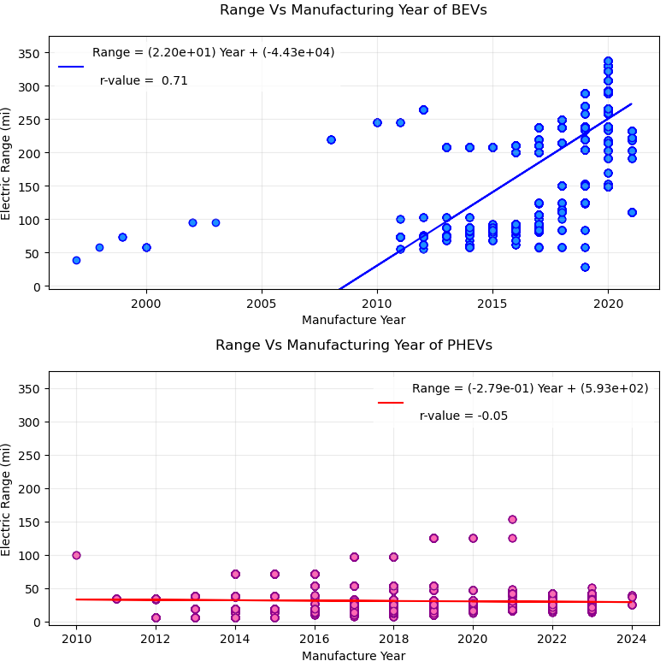
Electric Range vs. Year of Manufacturing for EVs
(BEV) As years progress, roll-out of electric vehicles with higher electric ranges were introduced; range is improving over time
(PHEV) Slower progress in relation to BEVs; range improvement is not significant

Slide 13
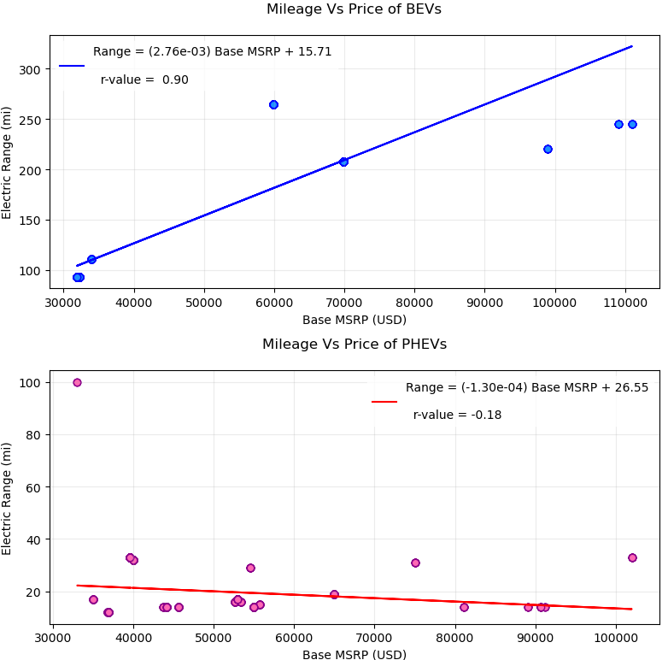
Mileage vs. Price of Electric Vehicles
(BEV) Increased range; electric range improves as Base MSRP increases
(PHEV) electric range is relatively the same even if the Base MSRP increases

Slide 14
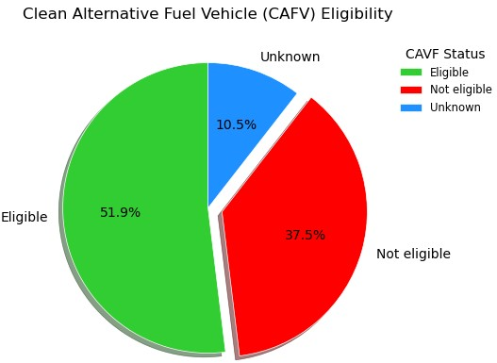
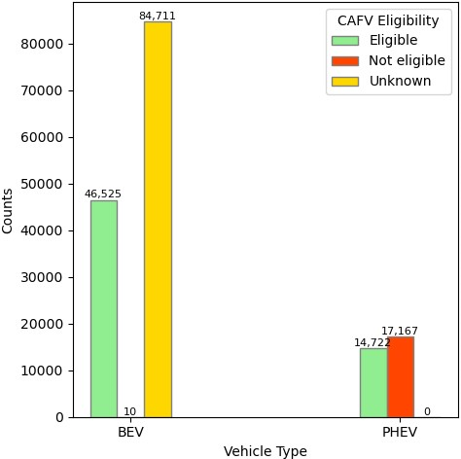
Clean Alternative Fuel Vehicle (CAFV) Eligibility

Slide 15
Any Questions?

Slide 16
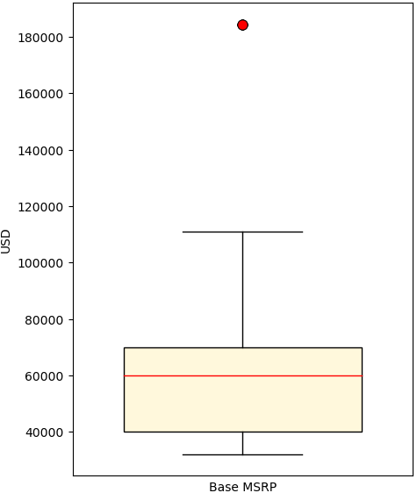

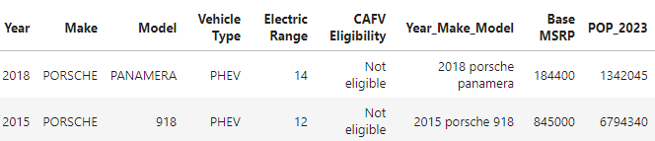
Extreme Outliers for Base MSRP

Slide 17
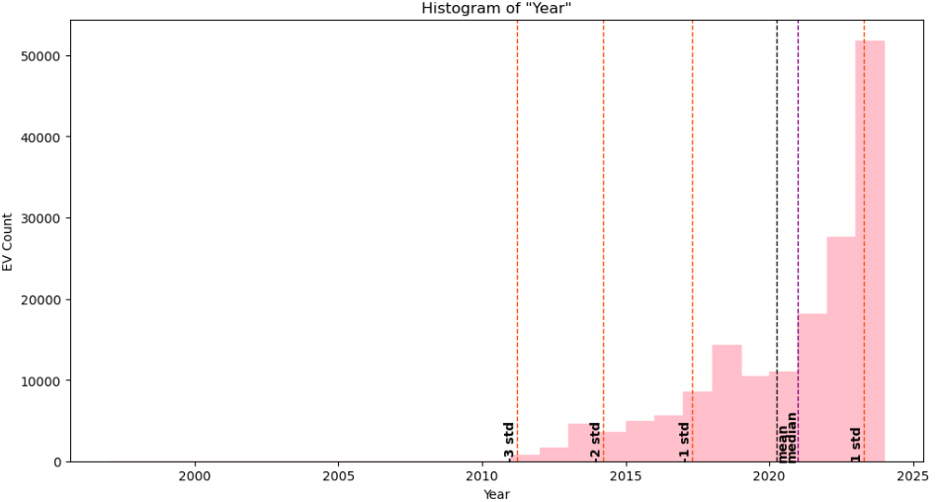
Data Distribution within Boxplot for EV count per year

Slide 18
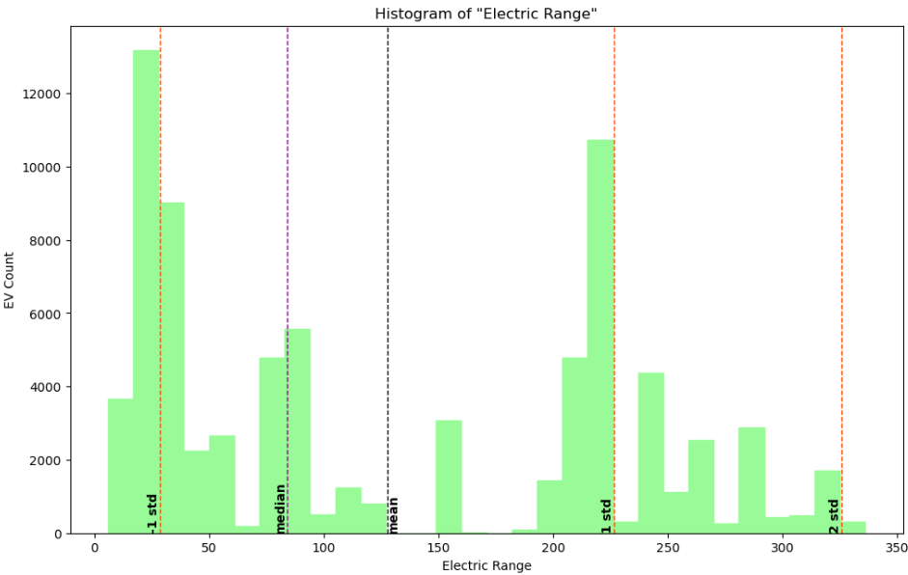
Data Distribution within Boxplot for EV count for Battery Range

Slide 19
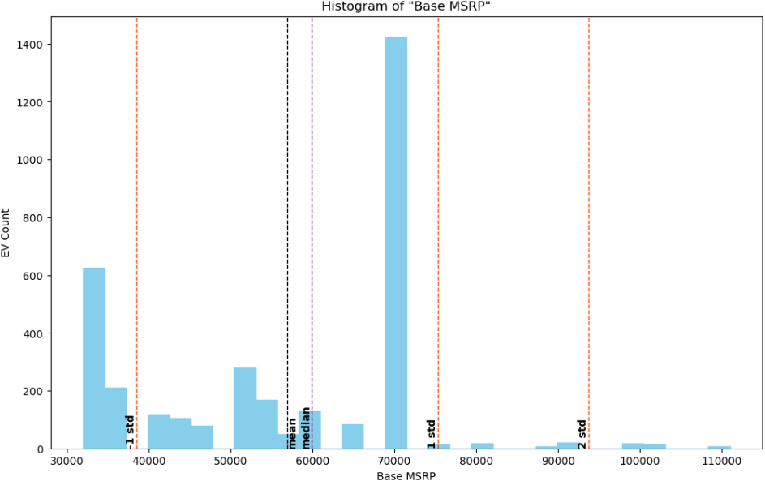
Data Distribution within Boxplot for EV count for Base MSRP

